Slide 1


Slide 2

Thank you!

Slide 3
Announcements
Anyone hiring?
Anyone looking for a job?
Anything else we should be aware of?

Slide 4
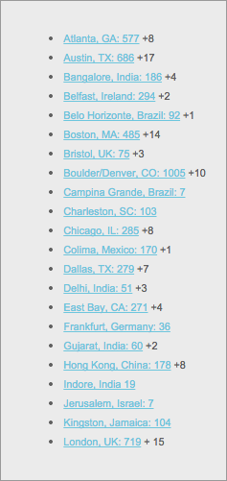
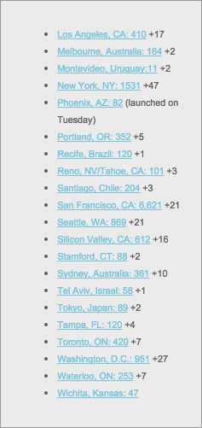
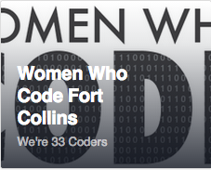
WWC Chapters
WWC Fort Collins is live...
Spread the word and show your support!

Slide 5
And Now…
Tonight’s Presentation:
Distributed Systems with Tim Berglund

